Slide 1

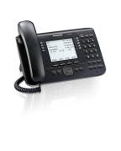
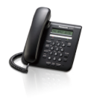
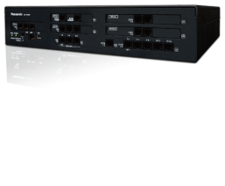
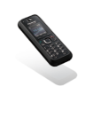
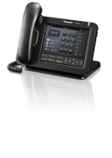

Slide 2
Contents
Introduction
Improved Work Efficiency
35
36
Product Concept
Product Overview
System Connection Diagram
5
6
14
Built-in DISA
Call Centre Solution
Queue Announcement
Call Distribution
Automatic Two-way Recording for Managers
NAS Supported
Activity Monitor
Activity Report
Communication Assistant
37
38
39
40
Selling Points
Why the KX-NS500 ?
16
4142
43
Cost Saving
1718
19
20
21
22
23
Expandability
Backwards Compatibility
IP Networking
Saving Communication Costs
Saving Network Costs
Saving on Initial Investment
Saving Running Costs
Simplified Maintenance
Web Maintenance
44
Appendix
Specifications
KX-NS500 Capacity
Hardware Condition
Product Lineup - Hardware
Product Lineup - Preinstalled Activation Keys
Product Lineup - Activation Keys
4649
50 51
52
Customer Satisfaction
24
Wireless Solution
Multi Zone
XDP Parallel Mode
DECT Paging
Tough Type Handset
Cellular Phone Integration
Receive a Call
Outside Destinations in Incoming Call Distribution Groups
Make a Call
Voice Mail Solution
Voice Mail
E-mail Notification
MS Outlook & IMAP4 Integration
2526
27
28
29
30
31
Terminal Information
Overview
IP Phone ‘KX-NT5xx Series’
Digital Phone ‘KX-DT5xx Series’
Wireless Terminal
5758
63 66
Improved Work Efficiency
32
33 34
Call Centre Solution
“CC View” Activity Monitor and Report Tool
71
Communication Assistant
72

Slide 3

Introduction

Slide 4


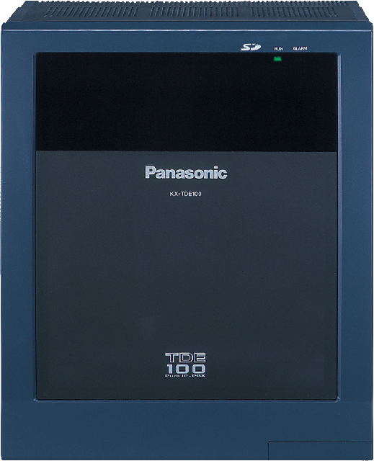



Product Concept
The KX-NS500 is the successor to the KX-NCP, KX-TDE100, and KX-TDA100D for the SMB market and comes built-in with the functions of the KX-NS1000.
Smart Hybrid PBX
KX-NS500
KX-NCP Series
KX-TDE100
KX-NS1000
KX-TDA100D
•Unified Communication
Full Voice Mail
Call Centre Function
Mobility
•Web Maintenance Console
•QSIG Networking
•IP Expansion
•CA Integration
•APT Compatible
•Legacy Expansion
•Built-in Message Card
•DPT Programming
5

Slide 5

- Product Overview
One Package Platform for Your Business
The KX-NS500 is a Smart Hybrid PBX suitable for small to medium sized offices. It enables you to provide various solutions with its built-in functions.
Smart Hybrid System
Preinstalled Activation Keys
Call Centre Solution
One Numbered Extension
One Package Platform for Your Business
Simplified Maintenance
Built-in Voice Mail/
UC Server
Smart Hybrid PBX
KX-NS500
6

Slide 6


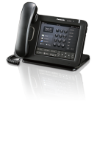
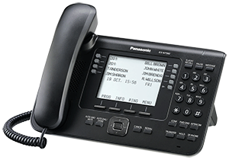


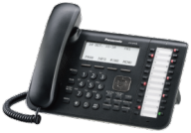



- Product Overview
Smart Hybrid System
The KX-NS500 has sufficient capacity for both legacy and IP ports, and an activation key or expansion cabinet can be used to easily expand the system according to customer needs.
SIP Trunk
KX-NS500
KX-NS520
PSTN/
ISDN
KX-NS520
KX-NS520
IPPT/SIP Phone
Max. 128
DPT/SLT
Max. 130
(Max. 160*)
Maximum Trunks and Extensions
Types |  | Preinstalled | KX-NS500 | With 1 | With 2 | With 3
 |  |  |  | KX-NS520 | KX-NS520 | KX-NS520
Legacy | Trunks | 6 ch | 36 ch | 66 ch | 96 ch | 126 ch
 | Extensions (DXDP*) | 18 | 34 (40) | 66 (80) | 98 (120) | 130 (160)
IP | Trunks | N/A | 64 ch | 64 ch | 64 ch | 64 ch
 | Extensions | N/A | 128 | 128 | 128 | 128
* When Digital XDP is used.
7

Slide 7
- Product Overview
Preinstalled Activation Keys
The following type and number of activation keys are preinstalled or come with a 60-days free trial on the mother board.
Smart Hybrid PBX
KX-NS500
Preinstalled Activation Keys
Free Activation Keys
60-days free trial
4 IP-PTs user
2 ch Unified Messages
CA Basic-Express for all users
Unified Messaging
(UM/E-mail Client/Message Backup/
Two-way Recording)
Mobile Extension
Communication Assistant
(CA PRO/CA Supervisor/CA Operator Console/CA Thin Client Server/CSTA Multiplexer)
3rd Party CTI interface
Call Centre Enhancement
* DSP is required for some functions.
8

Slide 8


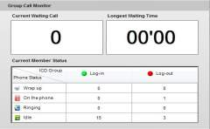

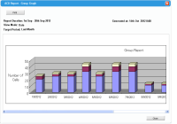
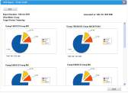

- Product Overview
Call Centre Solution
The KX-NS500 is designed to be used in call centre environments. Its built-in applications support the basic needs of supervisors at call centres, such as Queue Announcement, Live Status Monitor, Activity Report, Automatic Conversation Recording, and NAS (Network Attached Storage).
Queue Announcement
“Four other people are waiting to connect”
“And your estimated wait time is around 10 minutes.”
:
KX-NS500
Live Status Monitor
Record conversation
Customer
Agent
Save the voice data
Activity Report
NAS Server
Supervisor
9

Slide 9


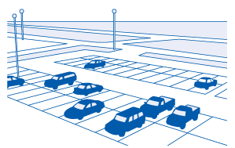




- Product Overview
One Numbered Extension
Up to two extensions can be assigned the same extension number. For example, calls to an extension in the office can be received simultaneously on a softphone on a smartphone. Calls can also be switched between paired phones with a simple operation.
Head Office
Outside
KX-NS500
Call
IP
Networking
Customer
Softphone
Extension
#200
Base station
Extension
#200
One number
10

Slide 10





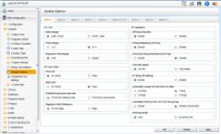
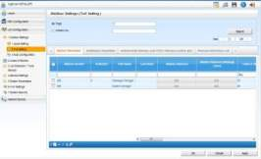
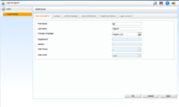
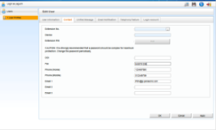
- Product Overview
Simplified Maintenance
The installer can easily program everything related to functions such as PBX and VM by web based console, because the KX-NS500 comes with a built-in web server. Programming can also be performed from remote sites. Users can also use a web based console to configure terminals and the VM mailbox.
Installer Office
Web based Maintenance
Public/Private
IP Network
KX-NS500
Fwd/DND, VM greetings, and e-mail addresses etc…
can be set from a PC
Web Console
No need to install dedicated software on your PC
User
<Note>
The programming method is basically same as the KX-TDA/TDW/NCP and KX-TVM.
Programming can be performed with PTs, in the same way as the KX-TDA100D.
11

Slide 11






- Product Overview
Built-in Voice Mail/UC Server - Unified Communication
The KX-NS500 has a built-in messaging system that provides voice mail to subscribers. The Unified Messaging system can also provide voice guidance to outside callers, either directing them to their desired destination or to the mailbox of a subscriber, where they can leave a voice message.
Voice Mail Server
UC Server
Communication Assistant
wav file
Built-in
Smart Hybrid PBX
KX-NS500
E-mail Notification Function
MS Outlook &
IMAP4 Integration
- Voice mail notification
- System alarm notification
- And more….
- Microsoft Outlook plug-in
- IMAP4 protocol supported
12

Slide 12


- Product Overview
Comparison with TDA/NCP/TDE Series
The KX-NS500 is more improved and varied than the KX-TDA/NCP/TDE series.
Model No.
Trunk Capacity | Legacy: Max 126 IP: Max 64 | Legacy: Max 106 | Legacy: Max 64 IP: Max 64 | Legacy: Max 128 IP: Max 64
Extension Capacity | Legacy: Max 160 IP: Max 128 | Legacy: Max 128 IP: Max 112 | Legacy: Max 44 IP: Max 128 | Legacy: Max 256 IP: Max 192
Built-in Voice Mail | Full VM functions Unified Message | ESVM | ESVM | ESVM
Maintenance | Web console/ proprietary telephone | PC maintenance console/ proprietary telephone | PC maintenance console/ proprietary telephone | PC maintenance console/ proprietary telephone
KX-NS500
KX-TDA100D
KX-NCP Series
KX-TDE100
13

Slide 13










System Connection Diagram
Existing equipment from Panasonic and trunks can continue to be used, and the legacy capacity can easily be expanded simply by connecting an expansion cabinet.
Branch Office
Head Office
Expansion cabinet
LAN
IP proprietary phones/
SIP phones etc.
KX-NS520
IP proprietary phones
APT
DPT
SIP phones
Branch Office
IP Network/
ITSP
QSIG Networking
-KX-NS series
-KX-NCP series
-KX-TDE series
-KX-TDA100D
Smart Hybrid PBX
KX-NS500
IP conferencing phones
IP cell stations/
SIP cell stations
Portable stations/
SIP portable stations
Remote maintenance PC
SLT/
FAX
E1/PRI Trunk Adaptor
UPS
PC (client)
-CA client
-IP softphones
SIP Trunk/
PSTN/
ISDN
SIP
Doorphone/
door opener
Analogue Line/
E1/PRI (30 ch)
Amplifier/
pager/
speaker
Web maintenance
console
BGM/
music on hold
CTI server
14

Slide 14
Selling Points

Slide 15
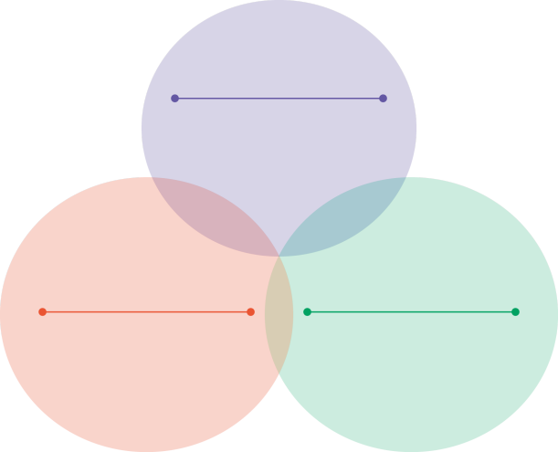
Selling Points
Why the KX-NS500 ?
Support for various features enhances business productivity. The KX-NS500 offers a Unified Communication System and it is suitable for small to medium sized businesses.
Smart Hybrid PBX
KX-NS500
Cost Saving
• Expandbility
• Backwards Compatibility
• IP Networking
Customer Satisfaction
Improved Work Efficiency
• Wireless Solution
• Cellular Phone Integration
• Voice Mail Solution
• Built-in DISA
• Call Centre Solution
• Communication Assistant
16

Slide 16




Head Office
Home Office
2F
Saving on Initial Investment
See page 22
Saving Running Costs
See page 23
Saving Communication Costs
See page 20
1F
Remote Office
KX-NS500
KX-NS500
Saving Network Costs
See page 21
Backwards Compatibility
See page 19
Expandability
See page 18
17

Slide 17




Expandability
The KX-NS500 is expandable with optional cards and expansion cabinets.
KX-NS500
KX-NS500
KX-NS520
Features and Benefits
You do not need to discard the KX-NS500 to increase capacity in the future.
Connecting an expansion cabinet is like connecting the KX-TDA600 and KX-TDA620.
KX-NS500
KX-NS520
KX-NS520
Recommended for:
KX-NS500
Growing companies
KX-NS520
KX-NS520
KX-NS520
Maximum Trunks and Extensions
Types |  | Preinstalled | KX-NS500 | With 1 | With 2 | With 3
 |  |  |  | KX-NS520 | KX-NS520 | KX-NS520
Legacy | Trunks | 6 ch | 36 ch | 66 ch | 96 ch | 126 ch
 | Extensions (DXDP*) | 18 | 34 (40) | 66 (80) | 98 (120) | 130 (160)
* When Digital XDP is used.
18

Slide 18



Backwards Compatibility
Existing DPTs, APTs and SLTs from Panasonic and Trunk can continue to be used, enabling a system to be replaced at a low cost without wasting resources.
Old System
KX-TD1232
KX-TE Series
Features and Benefits
Low initial investment costs because the only cost involved is that for purchasing the system.
Continue to use an existing KX-T74xx/KX-T75xx.
APT
DPT
SLT
APT
SLT
Recommended for:
Growing companies
Companies considering replacing their PBX
New System
KX-NS500
KX-NS500
APT
DPT
SLT
APT
SLT
19

Slide 19

IP Networking -Saving Communication Costs-
The adequate IP capacity of the KX-NS500 enables you to combine both IP and legacy trunks according to your needs, to construct systems that are flexible and cost effective.
Head Office
Features and Benefits
KX-NS500
Constructing a hybrid system that combines both legacy and IP lines to further reduce costs.
SIP
Trunk
Recommended for:
ISDN/
PSTN
Companies using an IP/ISDN/PSTN network system.
20

Slide 20
IP Networking -Saving Network Costs-
VoIP allows you to talk with your remote offices anywhere in the world without telephone charges using a private IP network.
Ext.1000 …
Ext.1999
Dials [2999]
Features and Benefits
Save on call costs.
The PBX extension functions can be used across multiple offices.
KX-NS500
IP
Networking
Recommended for:
Companies which have branches.
Companies using an IP network system.
KX-NS500
KX-NS500
Ext.2000 …
Ext.2999
Ext.3000 …
Ext.3999
21

Slide 21


IP Networking -Saving on Initial Investment-
IP phones can be installed at a remote office without a PBX via an IP network. A VPN is not required. (Built-in Media Relay GW)
Head Office
Home Office
Features and Benefits
MRG
No need to install the PBX in branch offices.
Built-in
KX-NS500
Not necessary
Recommended for:
Companies with employees working at home
IP
Networking
IP proprietary telephone
22

Slide 22
IP Networking -Saving Running Costs-
By using IP phones as extensions, there is no need to change the settings of the PBX each time the office layout is changed.
Office
Features and Benefits
2F
No need to change the PBX settings when phones are moved to another place.
Recommended for:
Companies with a need to change their office layout on occasion.
Companies which have an LAN network system.
Growing companies
KX-NS500
Simple move
1F
IP proprietary telephones
23

Slide 23







3F: Warehouse
Multi Zone
See page 25
Branch Office
Tough Type Handset
See page 28
DECT Paging
See page 27
XDP Parallel Mode
See page 26
2F: Office
1F: Office
Voice Mail
See page 32
E-mail
server
Outside Destinations in
Incoming Call Distribution Groups
See page 30
KX-NS500
One Numbered Extension
See page 29, 31
E-mail Notification
See page 33
MS Outlook &
IMAP4 Integration
See page 34
24

Slide 24



Wireless Solution -Multi Zone-
You can receive customer calls wherever you are in the company. Automatic hand-over allows smooth conversations on the move.
Features and Benefits
Office
KX-NS500
On-site employees: efficient because it is not necessary to return to the office to make a call.
Call receptionists: less trouble because the person to transfer the call to can be reached anywhere
Customers: improved customer satisfaction with less customer waiting because calls can be quickly transferred to the wireless handset of the person in charge.
Repeater Use: Call zone expansion can be enabled at a low cost because it is not necessary to wire extra cell stations to the PBX.
Wireless solutions can be easily installed at remote sites using an IP network.
LAN
Repeater
D-CS
Hand-over
IP Networking
IP-CS
Recommended for:
Dedicated employees stationed for receiving phone calls
Employees often away from their desks
Hand-over
Warehouse
25

Slide 25



Wireless Solution -XDP Parallel Mode-
Both a proprietary phone on the user's desk and a portable station can be called simultaneously using a single extension number.
Features and Benefits
Calls can be switched between desk phones and portable stations with a simple operation during conversations.
Switch from DECT simply by picking up the handset of your desk phone when you return to your seat.
Switch to DECT simply by pressing a button on the portable station when you leave your seat.
Customer
KX-NS500
Recommended for:
Extension
#200
Employees often going back and forth from their desk to make calls
For executive rooms and reception corners
26

Slide 26
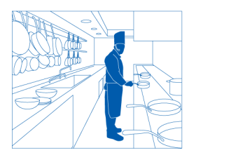





Wireless Solution -DECT Paging-
Paging can be performed between a maximum of 32 DECT wireless extensions. You can give directions to staff around the premises. This enables customers to be quickly responded to.
Max : 32 parties
Features and Benefits
Conversations between staff can be shared.
Multiple people can be called at the same time.
Contact made anywhere within the coverage area.
Recommended for:
Hotel, healthcare, or retail customers, etc. that require speedy sharing of information to share instructions with the relevant parties at the same time.
Companies with relevant parties in different locations.
<Note>
The availability of this function depends on the portable station model.
27

Slide 27



Wireless Solution -Tough Type Handset-
Dust resistance and water resistance for use in locations with high amounts of dust and humidity (IP65 Compliant).
This enables customer calls to be received in damp or dusty locations without concern.
Tough type model
KX-TCA385
Features and Benefits
IP6
Dust
resistance
In humid or dusty environments, repair costs can be reduced compared to non-resistant models.
Water resistance
IP5: Water resistance, protection against splashed water.
Dust resistance
IP6: Dust resistance, no invasion of dust.
IP5
Splash
proof
Recommended for:
Environments with warehouses and garages
Locations near kitchens, baths, etc.
28

Slide 28



Cellular Phone Integration -Receive a Call-
When your customer calls your office phone number, both your phone at the office and your cellular phone can ring at the same time. You can receive customer calls both inside and outside the company.
Office
Features and Benefits
092-123-4322
You only need to inform the customer of your office phone number.
Calls can be received with both a cellular network or IP network.
KX-NS500
Customer
092-123-4322
Recommended for:
Businesspeople that work both inside and outside the company.
Extension #100
Outside
Cellular Network
Base station
Cellular Phone
080-888-7777
29

Slide 29



Cellular Phone Integration -Outside Destinations in Incoming Call Distribution Groups-
Up to four cellular phones can be assigned as members of an Incoming Call Distribution (ICD) group, and receive calls to the group. Users who are not busy can quickly respond to customer calls.
Office
Outside
Features and Benefits
When a customer calls, both extensions and a registered cellular phone can be made to ring, enabling the call to be received with either phone.
Up to four cellular phones can be registered to an ICD group with other wired extensions.
KX-NS500
PSTN/IP Trunk
Customer
Cellular Network
Recommended for:
Companies with not many people available to answer the phone
Companies with many employees working outside of the office
Simultaneous ringing
Incoming Call Distribution group
30

Slide 30


Cellular Phone Integration -Make a Call-
Smart Remote Extension
You can install IP telephones in remote locations, such as the outside, without a special router. And up to two IP extensions can be assigned the same extension number. (One Numbered Extension)
Office
Features and Benefits
092-123-4322
Extensions can be configured remotely and easily.
You can use smartphones as extensions.
Use an SIP software phone to call customers when you are away from the office without any additional fees.
The customer is notified of your office phone number instead of the number of your cellular phone.
KX-NS500
Customer
092-123-4322
Extension #100
Outside
Recommended for:
IP Networking
Businesspeople that work both inside and outside the company.
SIP software
Phone
Base station
080-888-7777
31

Slide 31


Voice Mail Solution -Voice Mail-
Customers can leave voice mail if they call when you are away.
Features and Benefits
Record a maximum of 24 channels at the same time.
Record up to 400 hours.
Customer or
other extension
Mailbox
KX-NS500
101 | 104
102 | 105
103 | :
Recommended for:
Companies which get calls outside of business hours.
Employees who work away from the phone or out of the office.
Hello, this is Tom.
Please leave a voice message.
101
Susan
102
Mike
103
Tom
No answer
32

Slide 32


Voice Mail Solution -E-mail Notification-
The KX-NS500 sends an e-mail to the corresponding user when they have new messages. Missed calls without a voice message also can be e-mailed. This enables you to contact customers quickly.
A customer leaves VM or disconnects the call without leaving VM.
Features and Benefits
Customer
The notification contains information regarding the sender of the message, the length of the message, the number of messages, and a callback number.
Office
KX-NS500
Recommended for:
Companies which get calls outside of business hours.
Employees who work away from the phone or out of the office.
E-mail
server
With VM attached/
missed call notification
Outside
33

Slide 33
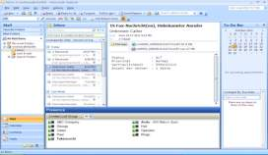
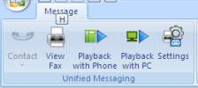
Voice Mail Solution -MS Outlook & IMAP4 Integration-
The KX-NS500 works as a voice IMAP4 server, so users can access the content of their mailboxes using a common e-mail client which supports the IMAP4 protocol. With the Microsoft Outlook plug-in, users can access the content of their mailboxes through Microsoft Outlook in the same way as they do for e-mail.
With IMAP integration, users can do the following:
- Play back voice messages
- Save voice data to their PCs
- Delete voice messages
Features and Benefits
Voice mail/
IMAP4 server
Users can easily listen to and transfer voice messages.
A UC environment that includes voice messages, e-mail, an SNS, and a scheduler can be constructed with Outlook alone.
KX-NS500
Common email application supporting IMAP4
Recommended for:
With the Outlook plug-in, users can do the following:
- Play back voice messages
- Record and send voice messages
- Forward and reply to messages
- Call back the sender of a message
- Export voice message data
- Attach voice messages to other e-mail messages
Companies that require information to be shared between agents
Companies using Outlook
Companies that want to construct an efficient office environment that integrates various communication methods
34

Slide 34




Call Distribution
See page 38
Call Centre
Queue Announcement
See page 37
KX-NS500
Built-in DISA
See page 36
Automatic Two-way Recording for Managers
See page 39
NAS Supported
See page 40
Activity Monitor
See page 41
Activity Report
See page 42
Office
KX-NS500
Communication Assistant
See page 43
35

Slide 35
Built-in DISA
Transfer customer calls without an operator.
Thank you for calling Panasonic
For an operator, press 0.
For sales, press 1.
For technical support, press 2.
Features and Benefits
These features provide users with greater flexibility and increase staff productivity.
Human resources currently used for operators can be assigned other work.
Customer
KX-NS500
For the Asian section, press 0. For the European section, press 1.
For Daniel, press 0.
For David, press 1.
For Lisa, press 2.
Recommended for:
0
Companies which have various departments.
Companies which get specific calls which need to be answered by the person in charge.
(Operator)
1
0
(Sales)
(Asia)
2
1
0
(Technical Support)
(Europe)
(Daniel)
3
2
1
(Planning)
(USA)
(David)
2
(Lisa)
36

Slide 36




Call Centre Solution -Queue Announcement-
The caller hears automatic voice guidance, enabling them to recognize their position in the call waiting queue. They can decide whether to stay in the queue or leave a message and hang up.
Features and Benefits
Call
Customers can be notified of estimated waiting times.
Customers can choose to leave a message or wait, according to their circumstances.
Customer
Agent
Call
Customer
Agent
Recommended for:
Call
Companies with not enough agents for the number of customer queries they receive
Companies that receive many customer queries and have not been able to respond to them all
Customer
Agent
Waiting
Customer
Waiting
Customer
“One other person is waiting to connect”
“And your estimated wait time is around 5 minutes.”
37

Slide 37

Call Centre Solution -Call Distribution-
The KX-NS500 provides a variety of call distribution options.
Ring all extensions
UCD (Uniform Call Distribution)
Ring all extensions
Ring the next extension
Features and Benefits
KX-NS500
KX-NS500
Various types of call distribution enables customer waiting time and stress to be reduced.
For example, when a call comes in to a busy line or an unattended phone, the system can distribute it to another extension, a voice mail system, a home or mobile telephone, or other pre-programmed destinations.
<A>
<B>
<C>
<D>
<A>
Busy
<B>
<C>
<D>
ACD (Automatic Call Distribution)
Overflow Extension
Ring the extension idle for the longest time
Ring the overflow extension, if all extensions in the group are busy
KX-NS500
KX-NS500
Recommended for:
3F
2F
Busy
Overflow
Companies which want to perform efficient call operations without installation of a special and expensive call centre system
<A>
<B>
<C>
<D>
Busy
Idle for 3 min.
Idle for 2 min.
Idle for 5 min.
<A>
<B>
<C>
<D>
Priority Hunting
Only if A is busy, ring the next extension
Login / Logout
Allows agents to log into a ring group with an ID number. All calls received by the agent are displayed on the report until the agent has logged out.
KX-NS500
KX-NS500
Ring A priority
<A>
<B>
<C>
<D>
Busy
<A>
<B>
<C>
<D>
Programmed Order: A⇒B⇒C⇒D (except with “Ring all extensions”)
38

Slide 38
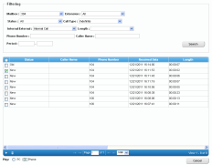
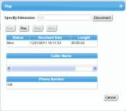

Call Centre Solution -Automatic Two-way Recording for Managers-
Calls to and from all extensions can be automatically recorded to a mailbox.
All extensions
Features and Benefits
Calls
Extensions can be assigned to a supervisor.
Supervisors can listen to the recorded conversation through the Web Maintenance Console.
Recorded data can be played back anytime the supervisor requires.
Recorded data can be used to understand problems with agents, and then instruct those agents to improve customer service.
Customer
Agent
Automatic
recording
Web Maintenance Console
UM
Mailbox
Confirm the conversation
Recommended for:
Companies that want to educate employees
Companies receiving increasing numbers of complaints from customers
Supervisor
39

Slide 39

Call Centre Solution -NAS Supported-
Since the KX-NS500 supports connecting with NAS (Network Attached Storage), it can make a backup of voice data to NAS to enable supervisors to listen to the saved data when required.
Record conversation
KX-NS500
Features and Benefits
Supervisors can use the backup data to understand problems or opportunities relating to customer service.
Customer
Save the voice data
Recommended for:
NAS Server
Companies that often have the need to listen to the content of conversations again
Companies that want to improve the customer handling of agents
Companies that want to share information between agents
Listen
Supervisor
40

Slide 40

Call Centre Solution -Activity Monitor-
The call centre supervisor can monitor the status of each agent and extension group.
Call
Features and Benefits
Customer A
Agent A
Since the call status can be monitored in real time, customer waiting times can be understood, and calls can be transferred to other agents or handled by the supervisor, etc., to reduce customer waiting time and stress.
Customer B
Call
Agent B
Recommended for:
Companies that want to perform operations efficiently and in real time
Companies that want to discover what problems they have
Waiting
Leave desk
Customer C
Agent C
Live Status Monitor
Supervisor
41

Slide 41
Call Centre Solution -Activity Report-
The call centre supervisor is also provided a variety of reports for studying the activity of the KX-NS500.
Features and Benefits
Reports can be made by agent and also by group.
Since reports are provided in various formats, they can help analysis the call status.
Call data for up to 300,000 calls can be stored.
Group 1
Agent A
Group 2
Agent B
Group 1
Agent C
Group 2
Agent D
KX-NS500
Recommended for:
Companies that want to discover/analyze current problems
Companies that want to perform continuous analysis to improve customer satisfaction
Supervisor
Activity Report
42

Slide 42

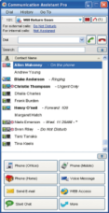







Communication Assistant
Communication Assistant (CA) productivity software is a highly intuitive PC based application that enables you to change the contact method according to the status of the other party.
Communication Assistant
Extension Status
Idle
Call
desk phone
Features and Benefits
Ringing
Available
Enables the presence of co-workers to be checked to select the appropriate communication method
Four editions (Basic/Pro/Console/Supervisor) available to meet various needs.
Can be linked with various applications
Check
presence / status
On the phone
CA Status
The user is logged in
On the
phone
The user is logged in, but the auto absent message has been set
Chat
The user isn't logged in
Absent Message
Gone
home
Recommended for:
Voice mail/
e-mail
Will Return Soon
Employees often away from their desks
Companies with relevant parties in different locations.
Companies which have branches.
Not At My Desk
Gone Home
Available
Not at
desk
Call
cellular phone
Urgent Only
In a meeting
43

Slide 43
Selling Points
Simplified Maintenance -Web Maintenance-
The features described on previous pages can be programmed with a Web based console via an IP network. Phones and the VM mailbox can also be customised by users via the Web.
Installer Office
Web Maintenance
Public/Private
IP Network
KX-NS500
Programming is easy for experienced Panasonic installers because the programming method is basically the same as the KX-TDA, KX-TDE, KX-NCP and KX-TVM.
No need to install dedicated software on your PC.
Use an IP network to perform programming from remote sites.
A maximum of 1 installer can modify system data at the same time.
A maximum of 32 users can access at the same time.
User
Web Console
Fwd/DND, VM greetings, and e-mail addresses etc…
can be set from a PC
44

Slide 44
Appendix
* For details, see the latest Installation Manual.

Slide 45
Specifications
KX-NS500 Capacity
Maximum Trunks
 |  |  | Preinstalled | KX-NS500 | With 1 KX-NS520 | With 2 KX-NS520 | With 3 KX-NS520
Total Number of Trunks (Legacy+IP) |  |  | 6 ch | 100 ch | 130 ch | 160 ch | 190 ch
 | Legacy |  | 6 ch | 36 ch | 66 ch | 96 ch | 126 ch
 |  | PRI30 | N/A | 30 ch | 60 ch | 90 ch | 120 ch
 |  | E1 | N/A | 30 ch | 60 ch | 90 ch | 120 ch
 |  | Analogue | 6 lines | 12 lines | 24 lines | 36 lines | 48 lines
 | IP |  | N/A | 64 ch | 64 ch | 64 ch | 64 ch
 |  | H.323 | N/A | 32 ch | 32 ch | 32 ch | 32 ch
 |  | SIP | N/A | 64 ch | 64 ch | 64 ch | 64 ch
46

Slide 46
Specifications
KX-NS500 Capacity
Maximum Terminal Equipment
Type |  |  | Preinstalled | KX-NS500 | With 1 KX-NS520 | With 2 KX-NS520 | With 3 KX-NS520
Extensions (Legacy+IP) (DXDP^{*1}) |  |  | 18 | 162 (168) | 194 (208) | 226 (248) | 258 (288)
 | Legacy (DXDP^{*1}) |  | 18 | 34 (40) | 66 (80) | 98 (120) | 130 (160)
 |  | SLT | 16 | 32 | 64 | 96 | 128
 |  | DPT (DXDP^{*1}) | 2 (4) | 18 (24) | 34 (48) | 50 (72) | 66 (96)
 |  | APT | N/A | 8 | 16 | 24 | 32
 | IP |  | N/A | 128
 |  | IP-PT^{*2} | N/A | 128
 |  | SIP^{*3} | N/A | 128
CS |  |  | N/A | 20 | 24 | 28 | 32
 |  | PT-interface CS (2ch) / (8ch) | 2 / N/A | 4 / 2 | 8 / 4 | 12 / 6 | 16 / 8
 |  | IP-CS/SIP-CS | N/A | 16
PS |  |  | 128
VM
 |  | Built-in DISA (ch) | 2 | 64
 |  | Built-in SVM (ch) |  | 2
 |  | Built-in UM (ch) | N/A | 24
Doorphone |  |  | N/A | 2 | 4 | 6 | 8
Door Opener |  |  | N/A | 2 | 4 | 6 | 8
External Sensor |  |  | N/A | 2 | 4 | 6 | 8
*1 When Digital XDP is used. *2 KX-NT500/300 Series, KX-NT265 (software version 2.0 or later only). *3 KX-UT Series, KX-NT700 and third party SIP phones (SIP hard phones/SIP softphones).
47

Slide 47
Specifications
KX-NS500 Capacity
Communication Assistant
 |  | CA Basic-Express | CA PRO | CA Operator Console | CA Supervisor
Maximum Users | Without CA Server | 240 | 240 | 128 | 4
 | With CA Server | 416^{*1} | 416^{*1} | 128 | 128
Activation Key |  | Preinstalled for all users | 60-days free trial for 128 users | 60-days free trial for 1 user | 60-days free trial for 1 user
Automatic Presence |  | N/A | Yes
Call Contact |  | 10 | 1000
Call History |  | 10 | 1000
Chat |  | Yes | Yes
Conference Features |  | N/A | Yes
Flexible Call Handling/ Monitor & Seize CO line |  | N/A | N/A | Yes | N/A
Listen-in/ Busy Override/Take Over |  | N/A | N/A | Yes | Yes
Multi Site Communication (Networking) |  | N/A | Yes
CRM Integration by TAPI |  | N/A | Yes
Thin Client Support |  | Yes | Yes
*1 Can be used by all extension users. Including IP/DPT(DXDP)/PS.
48

Slide 48
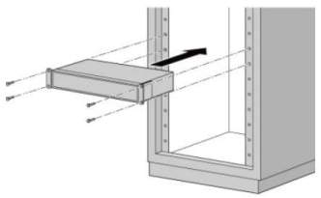
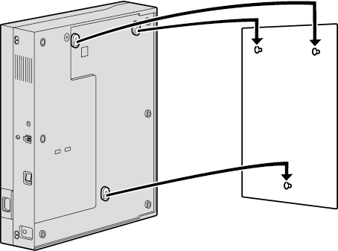
Specifications
Hardware Condition
Item | Specification
Temperature | 0 ˚C to 40 ˚C
Humidity | 10 % to 90 % (non-condensing)
Power Input | 100 V AC to 130 V AC: 2.2 A/200 V AC to 240 V AC: 1.3 A; 50 Hz/60 Hz
Power Consumption (when fully mounted) | 110 W
External Backup Battery | External battery port is supported.
Memory Backup Duration | 7 years
Air-cooling method | FAN
Dimension | 430 mm (W) x 88 mm (H) x 367 mm (D)
Weight (when fully mounted) | Under 4.5 kg
19-inch Rack Mounting
Wall Mounting
49

Slide 49
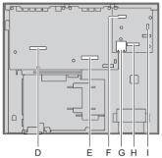
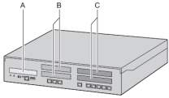
Specifications
Product Lineup - Hardware
Main Unit KX-NS500
A. Front cover plate for the EXP-M Slot
B. Front cover plates for Trunk/Doorphone Card Slots
C. Front cover plates for the Extension Card Slots
D. Extension Card Slot
E. Trunk/Doorphone Card Slot
F. EXP-M Card Slot
G. SD Card Slot
H. DSP Card Slot
I. RMT Card Slot
Option Unit in Main Unit
Component |  | Model | Description | Installed in
DSP | DSP S (63 resources) | KX-NS5110 | VoIP DSP Card (S Type) | DSP Card Slot
 | DSP M (127 resources) | KX-NS5111 | VoIP DSP Card (M Type)
 | DSP L (254 resources) | KX-NS5112 | VoIP DSP Card (L Type)
Storage Memory For VM, ACD Report, SMDR expansion | XS (40 hours) | KX-NS5134 | Storage Memory (XS Type) | Storage Memory Card Slot
 | S (200 hours) | KX-NS5135 | Storage Memory (S Type)
 | M (400 hours) | KX-NS5136 | Storage Memory (M Type)
Trunk | LCOT6 | KX-NS5180 | 6-Port Analogue Trunk Card | Trunk Slot
 | PRI30/E1 | KX-NS5290CE | PRI30 / E1 Trunk Card
 | DPH2 | KX-NS5162 | Doorphone Interface Card
Extension | DHLC4 | KX-NS5170 | 4-Port Digital Hybrid Extension Card | Extension Slot
 | DLC8 | KX-NS5171 | 8-Port Digital Hybrid Extension Card
 | DLC16 | KX-NS5172 | 16-Port Digital Hybrid Extension Card
 | MCSLC8 | KX-NS5173 | 8-Port SLT Card
 | MCSLC16 | KX-NS5174 | 16-Port SLT Card
Expansion Master Card | EXP-M | KX-NS5130 | 3-ports Expansion Master Card | EXP-M Slot
Remote Modem | RMT | KX-TDA0196 | Remote Modem Card | RMT Slot
50

Slide 50
Specifications
Product Lineup - Preinstalled Activation Keys
To use IP/SIP trunks and IP/SIP telephones and/or enabling the software for enhanced features, you need the appropriate activation keys. Customers can create their own optimized communication system by selecting various activation keys.
The following activation keys are preinstalled^{*1}
Activation Key |  | Feature | Expire
IP Phone | IP Proprietary Telephone (ch) | 4 IP-PTs/KX-UT series SIP phones | Permanent
Unified Messaging | UM Port (ch) | 2 Unified Messaging ports | Permanent
 | UM/E-mail Client | 128 users (128 mailboxes) | Expire after 60 days
 | Two-Way Recording Control | Automatic Two-way Recording Feature | Expire after 60 days
 | Two-Way Recording | 30 Two-way Recording/Two-way Transfer users | Expire after 60 days
 | Message Backup | Automatic backup of messages | Expire after 60 days
Mobile Extension |  | 30 users | Expire after 60 days
Call Centre Enhancement |  | Built-in ACD Report^{*2}, Announcement of waiting number for queuing | Expire after 60 days
Communication Assistant | CA Basic-Express | ALL users | Permanent
 | CA PRO | 128 users | Expire after 60 days
 | CA Supervisor | 1 user | Expire after 60 days
 | CA Operator Console | 1 user | Expire after 60 days
 | CA Thin Client Server | Using CA in a thin-client environment | Expire after 60 days
 | CSTA Multiplexer | Multiplexing for CSTA connections | Expire after 60 days
 | CTI interface | 3rd Party CTI interface | Expire after 60 days
Optional Activation Keys
Expand capacity
Network functions
Mobile extensions
Unified messaging
CA/CTI functions etc.
Preinstalled activation keys for basic functions
*1 DSP is required for some functions.
*2 An SD card is necessary to use ACD Reports.
51

Slide 51
Specifications
Product Lineup - Activation Keys
IP Trunks
Activation Key Type |  | Model No. | Description | Maximum
IP Trunks (H.323/SIP) | 2 IP Trunk | KX-NSM102 | 2-Channel IP Trunk Activation Key | SIP: 64 ch H.323: 32 ch
 | 4 IP Trunk | KX-NSM104 | 4-Channel IP Trunk Activation Key
 | 8 IP Trunk | KX-NSM108 | 8-Channel IP Trunk Activation Key
 | 16 IP Trunk | KX-NSM116 | 16-Channel IP Trunk Activation Key
Networking
Activation Key Type | Model No. | Description | Maximum
QSIG Network | KX-NSN002 | Activation Key for QSIG Networking | 1 activation key
System Function
Activation Key Type | Model No. | Description | Maximum
Call Centre | KX-NSF201 | Built-in ACD Report, Announcement of waiting number for queuing | 1 activation key
52

Slide 52
Specifications
Product Lineup - Activation Keys
IP Telephone - User
*IP PTs: KX-NT500/300Series IP Proprietary phones
*IP Softphones: KX-NCS8100 IP, KX-TDA0350
*SIP Phones: KX-NT700 IP Conferencing phone and Third party SIP phones (SIP hardphones/SIP softphones).
Activation Key Type |  | Model No. | Description | Maximum
*IP PTs/ KX-UT Series SIP Phones/ *IP Softphones/ | 1 ch | KX-NSM201 | 1-Channel IP Softphone / IP Proprietary Telephone Activation Key | 128 ch
 | 5 ch | KX-NSM205 | 5-Channel IP Softphone / IP Proprietary Telephone Activation Key
 | 10 ch | KX-NSM210 | 10-Channel IP Softphone / IP Proprietary Telephone Activation Key
 | 20 ch | KX-NSM220 | 20-Channel IP Softphone / IP Proprietary Telephone Activation Key
*IP PTs/ KX-UT Series SIP Phones | Up to 4 ch | - | Preinstalled
 | 1 ch | KX-NSM501 | 1-Channel IP Proprietary Telephone Activation Key
 | 5 ch | KX-NSM505 | 5-Channel IP Proprietary Telephone Activation Key
 | 10 ch | KX-NSM510 | 10-Channel IP Proprietary Telephone Activation Key
 | 20 ch | KX-NSM520 | 20-Channel IP Proprietary Telephone Activation Key
*SIP Phones | 1 ch | KX-NSM701 | 1-Channel SIP Extension Activation Key
 | 5 ch | KX-NSM705 | 5-Channel SIP Extension Activation Key
 | 10 ch | KX-NSM710 | 10-Channel SIP Extension Activation Key
 | 20 ch | KX-NSM720 | 20-Channel SIP Extension Activation Key
53

Slide 53
Specifications
Product Lineup - Activation Keys
Cellular Phone Extension - User
Activation Key Type |  | Model No. | Description | Maximum
Mobile Extension | 1 user | KX-NSE101 | Activation Key for Mobile Extension for 1 User | 128 cellular phone extensions
 | 5 users | KX-NSE105 | Activation Key for Mobile Extension for 5 Users
 | 10 users | KX-NSE110 | Activation Key for Mobile Extension for 10 Users
 | 20 users | KX-NSE120 | Activation Key for Mobile Extension for 20 Users
Unified Messaging System - Feature
Activation Key Type |  | Model No. | Description | Maximum
Two-way REC Control for Manager |  | KX-NSU002 | Activation Key for Two-way Recording Control | 1 activation key
Massage Backup |  | KX-NSU003 | Activation Key for Message Backup | 1 activation key
Unified Messaging Channel | 2 ch | - | Preinstalled on the Mother Board | 24 ch
 | 2 ch | KX-NSU102 | 2 Channel Unified Messaging Activation Key
 | 4 ch | KX-NSU104 | 4 Channel Unified Messaging Activation Key
54

Slide 54
Specifications
Product Lineup - Activation Keys
Unified Messaging System - User (Mailbox)
Activation Key Type |  | Model No. | Description | Maximum
E-mail (IMAP4) Client/ E-mail Notification | 1 user | KX-NSU201 | Activation Key for Unified messaging E-Mail Notification for 1 User | 500 mailboxes
 | 5 users | KX-NSU205 | Activation Key for Unified messaging E-Mail Notification for 5 Users
 | 10 users | KX-NSU210 | Activation Key for Unified messaging E-Mail Notification for 10 Users
 | 20 users | KX-NSU220 | Activation Key for Unified messaging E-Mail Notification for 20 Users
 | All users | KX-NSU299 | Activation Key for Unified messaging E-Mail Notification for All Users
Two-way Recording/ Two-way Transfer | 1 user | KX-NSU301 | Activation Key for Two-way Recording for 1 User | 416 users
 | 5 users | KX-NSU305 | Activation Key for Two-way Recording for 5 Users
 | 10 users | KX-NSU310 | Activation Key for Two-way Recording for 10 Users
 | 20 users | KX-NSU320 | Activation Key for Two-way Recording for 20 Users
 | All users | KX-NSU399 | Activation Key for Two-way Recording for All Users
55

Slide 55
Specifications
Product Lineup - Activation Keys
Communication Assistant - User
Activation Key Type |  | Model No. | Description | Maximum
CA Basic-Express | All users | - | Preinstalled | Without CA Server: 240 users With CA Server: 416 users
CA PRO | 1 user | KX-NSA201 | Activation Key for CA PRO for 1 User
 | 5 users | KX-NSA205 | Activation Key for CA PRO for 5 Users
 | 10 users | KX-NSA210 | Activation Key for CA PRO for 10 Users
 | 40 users | KX-NSA240 | Activation Key for CA PRO for 40 Users
 | 128 users | KX-NSA249 | Activation Key for CA PRO for 128 Users
CA Supervisor | 1 user | KX-NSA301 | Activation Key for CA ACD Monitor for 1 ICD Supervisor | Without CA Server: 4 users With CA Server: 128 users
CA Operator Console | 1 user | KX-NSA401 | Activation Key for CA Operator Console | Without CA Server: 128 users With CA Server: 128 users
CA Network Plug-in | 1 user | KX-NSA901 | Activation Key for CA Network Plug-in for 1 User | Without CA Server: 240 users With CA Server: 1022 users
 | 5 users | KX-NSA905 | Activation Key for CA Network Plug-in for 5 Users
 | 10 users | KX-NSA910 | Activation Key for CA Network Plug-in for 10 Users
 | 40 users | KX-NSA940 | Activation Key for CA Network Plug-in for 40 Users
 | 128 users | KX-NSA949 | Activation Key for CA Network Plug-in for 128 Users
Communication Assistant - External Interface
Activation Key Type | Model No. | Description | Maximum
CA Thin Client | KX-NSA010 | Activation Key for CA Thin Client Server Connection | 1
CSTA Multiplexer | KX-NSA020 | Activation Key for Multiple CSTA Connection
3rd Party CTI link | KX-NSF101 | Activation Key for CTI interface
56

Slide 56

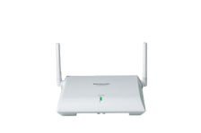

Terminal Information
Overview
Panasonic’s full terminal line up from high end to low end provide various solutions to various types of businesses.
IP Proprietary Telephone
- Gigabit LAN/PC port
- PoE
- Full duplex speakerphone
- Supports EHS for wireless headsets
Smart Hybrid PBX
KX-NS500
Digital Proprietary Telephone
- Full duplex speakerphone
- Supports EHS for wireless headsets
Wireless Terminals
- Multifunctional design
- Seamless communication while you move from place to place during a call
57

Slide 57
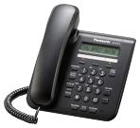
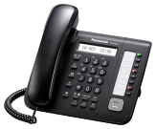
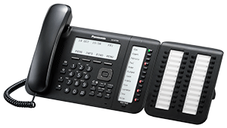
Terminal Information
IP Phone 'KX-NT5xx Series'
Lineup
For Executives/Supervisors
For Simple Users
KX-NT560
KX-NT511A/KX-NT511P
4.4 inch Backlight LCD Display
- 4 x 8 Self Labelling, Flexible CO Buttons
2 Giga Ethernet Ports (10/100/1000M)
PoE
Full Duplex Speakerphone
Electronic Hook Switch
Built-in Bluetooth Module
Eco Mode
- 1-Line LCD Display
3 Flexible CO Buttons
PoE (KX-NT511P only)
2 Ethernet Ports (10M/100M)
AC Adaptor Included (KX-NT511A only)
- Full Duplex Speakerphone
- Eco Mode
A white model
is available
for each phone
For Standard Users
KX-NT551
KX-NT556/KX-NT553 with KX-NT505
KX-NT546/KX-NT543
- 1-Line Backlight LCD Display
- 8 Flexible CO Buttons
2 Ethernet Ports (10/100/1000M)
Full Duplex Speakerphone
PoE
Eco Mode
6-Line Backlight LCD Display
(KX-NT553: 3-Line)
12 x 3 Self Labelling, Flexible CO Buttons
(KX-NT553: 12 x 2)
2 Ethernet Ports (10/100/1000M)
PoE
Full Duplex Speakerphone
Electronic Hook Switch
Eco Mode
Options: KX-NT505 (Add on 48 key module)
6-Line Backlight LCD Display
(KX-NT543: 3-Line)
- 24 Flexible CO Buttons
2 Ethernet Ports (10/100M)
PoE
Speakerphone
Electronic Hook Switch
Eco Mode
58

Slide 58

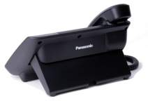

Terminal Information
IP Phone 'KX-NT5xx Series'
Features
High Audio Quality
Full duplex speakerphone (KX-NT560/KX-NT55x Series/KX-NT511)
The speakerphone supports "full duplex”, enabling both parties to speak at the same time without their voice getting cut out.
Supports the G.722 codec
G.722 codec provides calls with high quality and reduced stress.
Advanced speaker design
Speakers enhance the characteristics of low frequencies and contain a high performance D-class audio amp.
Larger acoustic chamber
The acoustic chamber reduces echo and vibration from the speaker.
Special material cone circle
Acoustic chamber
(acoustic box)
Hands Free Communication
Built-in Bluetooth (KX-NT560 only)
Bluetooth for wireless calls using a supported headset.
Electronic Hook Switch (EHS) supported (Except for KX-NT551/KX-NT511)
By connecting an EHS headset, you can perform wireless communication.
59

Slide 59

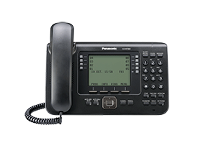
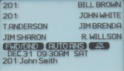

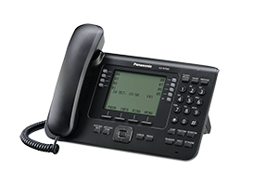
Terminal Information
IP Phone 'KX-NT5xx Series'
High Speed Communication
Supports Gigabit Ethernet (KX-NT560/KX-NT55x Series)
Enables high-speed data transfer.
Easy to Use Design
Paper label free (KX-NT560/KX-NT556/KX-NT553)
Since the numbers are displayed on the screen, a paper label is not required.
Small footprint reduces desk space
Longer handset curly cord
Paper label free
Small footprint
Longer handset curly cord
60

Slide 60
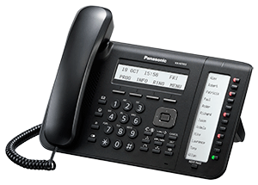

Terminal Information
IP Phone 'KX-NT5xx Series'
Specifications
Model Number |  | KX-NT551 | KX-NT553 | KX-NT556 | KX-NT560
Functions | LCD | 1-Line, Monochrome | 3-Line, Monochrome | 6-Line, Monochrome | 6-Line, Monochrome
 | Backlight | Yes
 | Speakerphone | Yes (Full Duplex)
 | FF Button | 8 | 2 x 12 (Self Labelling) | 3 x 12 (Self Labelling) | 4 x 8 (Self Labelling)
 | Bluetooth Headset Connectability | N/A |  |  | Built-in
 | Electronic Hook Switch | N/A | Yes^{*1}
 | Ethernet Port | 2 ports (10/100/1000M)
 | POE | Yes (802.3af compliant)
 | Others | IPv4, DHCP Client, Audio Codec (G.722/G.711/G.729a), Echo Cancellation, Microphone
Options | AC Adaptor | KX-A239
 | Wall Mount Kit | KX-A432 | KX-A433
 | Wired Headset | RP-TCA400/430
Others | Colour Variation | White, Black
*1: Only a Φ3.5mm pin jack is connectable.
Note: Some operations may vary depending on the type of telephone being used.
61

Slide 61

Terminal Information
IP Phone 'KX-NT5xx Series'
Specifications
Model Number |  | KX-NT511A | KX-NT511P | KX-NT543 | KX-NT546
Functions | LCD | 1-Line, Monochrome |  | 3-Line, Monochrome | 6-Line, Monochrome
 | Backlight | N/A |  | Yes
 | Speakerphone | Yes (Full Duplex) |  | Yes
 | FF Button | 3 |  | 24
 | Bluetooth Headset Connectability | N/A
 | Electronic Hook Switch | N/A |  | Yes^{*1}
 | Ethernet Port | 2 ports (10/100M)
 | PoE | N/A | Yes | Yes (802.3af compliant)
 | Others | IPv4, DHCP Client, Audio Codec (G.722/G.711/G.729a), Echo Cancellation, Microphone
Options | AC Adaptor | Attached | N/A^{*2} | KX-A239
 | Wall Mount Kit | Built-in |  | KX-A433
 | Wired Headset | N/A |  | RP-TCA400/430
Others | Colour Variation | White, Black
*1: Only a Φ3.5mm pin jack is connectable.
*2: Service parts
Note: Some operations may vary depending on the type of telephone being used.
62

Slide 62
Terminal Information
Digital Phone 'KX-DT5xx Series'
Lineup
For Executives/Supervisors
KX-DT546 with KX-DT590
- 6-Line Backlight LCD Display
- 24 Flexible CO Buttons
Full Duplex Speakerphone
Electronic Hook Switch
Options
KX-DT590: Digital DSS console (48-Key)
For Standard Users
KX-DT543
3-Line Backlight LCD Display
- 24 Flexible CO Buttons
Full Duplex Speakerphone
Electronic Hook Switch
Options
KX-DT590: Digital DSS console (48-Key)
For Simple Users
KX-DT521
- 1-Line Backlight LCD Display
- 8 Flexible CO Buttons
- Full Duplex Speakerphone
Options
KX-DT590: Digital DSS console (48-Key)
A white model
is available
for each phone
63

Slide 63
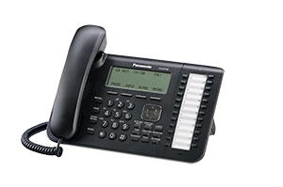
Terminal Information
Digital Phone 'KX-DT5xx Series'
Features
High Audio Quality
Full duplex speakerphone
The speakerphone supports “full duplex”, enabling both parties to speak at
the same time without their voice getting cut out.
Advanced speaker design
Speakers enhance the characteristics of low frequencies and contain a high
performance D-class audio amp.
Larger acoustic chamber
The acoustic chamber reduces echo and vibration from the speaker.
Special material cone circle
Acoustic chamber
(acoustic box)
Hands Free Communication
Electronic Hook Switch (EHS) supported (KX-DT546/KX-DT543)
By connecting an EHS headset, you can perform wireless communication.
Easy to Use Design
Small footprint reduces desk space
Longer handset curly cord
Small footprint
Longer handset curly cord
64

Slide 64

Terminal Information
Digital Phone 'KX-DT5xx Series'
Specifications
Model Number |  | KX-DT521 | KX-DT543 | KX-DT546
Functions | LCD | 1-Line, Monochrome | 3-Line, Monochrome | 6-Line, Monochrome
 | Backlight | Yes
 | Speakerphone | Yes (Full Duplex)
 | FF Button | 8 | 24
 | Bluetooth Headset Connectability | N/A
 | Electronic Hook Switch | N/A | Yes^{*1}
 | Ethernet Port | N/A
 | PoE | N/A
 | Others | Audio Codec (G.711), Echo Cancellation, Microphone, 1 DXDP Port
Options | AC Adaptor | N/A
 | Wall Mount Kit | KX-A432 | KX-A433
 | Wired Headset | KX-TCA400/430, RP-TCA400/430
Others | Colour Variation | White, Black
*1: Only a Φ3.5mm pin jack is connectable.
Note: Some operations may vary depending on the type of telephone being used.
65

Slide 65
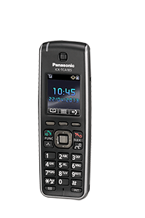
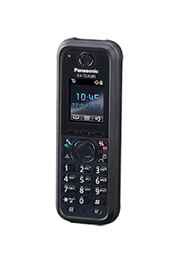
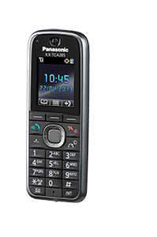

Terminal Information
Wireless Terminal
Lineup
Standard Model
Slim & Light Model
IP65* Tough Type Model
KX-TCA185
KX-TCA285
KX-TCA385
- Noise Reduction
- Built-in Bluetooth Headset interface (KX-TCA285/KX-TCA385)
- DECT Paging
- DECT for CTI
- Wireless XDP Parallel Function
*IP65 compliant: Protection against dust entering the handset, and protection against water spraying from any direction.
66

Slide 66



Terminal Information
Wireless Terminal
Features
Noise Countermeasures
Noise reduction
Detect and reduce the noise parts of transmitted voices
Dynamic listening volume control
When the KX-TCA series detects noise, it automatically increases the receiver volume to an easy-to-hear level.
Detect and remove
the background noise
Voice
Noise
Hands Free Communication
Built-in Bluetooth (KX-TCA285/KX-TCA385)
Bluetooth for wireless calls using a supported headset.
67

Slide 67



Terminal Information
Wireless Terminal
Specifications
Model Number | Standard Model KX-TCA185 | Slim & Light Model KX-TCA285 | IP65 Tough Type Model KX-TCA385
LCD | 1.8 inch TFT Colour
PBX Linked Feature^{*1} | Yes
Speakerphone | Yes (Full Duplex)
PBX Flexible CO Button | 12
Soft Keys | 3
Headset Jack | Yes^{*2} |  | N/A
Noise Reduction | Yes
Wireless XDP Parallel Function | Yes
Conference Function | Yes
DECT Paging | Yes
PS Ring Group | Yes
Vibration | Yes
Splash and Dust Resistant | N/A |  | IP65
DECT Encryption | Ready
*1 Examples: PBX Call Log/PBX System Phonebook/PBX Personal Programming etc.
*2 Only a Φ2.5mm pin jack is connectable.
68

Slide 68
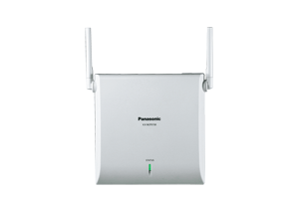
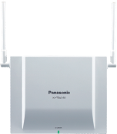
Terminal Information
Wireless Terminal
Specifications
IP Cell Station KX-NCP0158 | Cell Station KX-TDA0158
Wireless solution for remote office communication Provides 8 call user connections over 10/100Mbit LAN No special cabling required (overcomes distance issues) Air synchronization technology Powered by both PoE and AC adaptor (sold separately) No activation key requirements DHCP client/static address | Solution to the office with dense population of user customer Up to 8 simultaneous calls DTP-IF (4 DPT port) Powered by PBX No activation key requirements
69

Slide 69
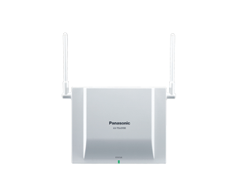
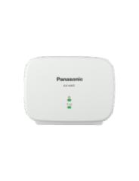
Terminal Information
Wireless Terminal
Specifications
Cell Station KX-TDA0155 | Repeater KX-A405
Up to 2 simultaneous calls DTP-IF Powered by PBX No activation key requirements | Designed to extend the range of a DECT Portable station Up to 6 repeaters can be registered to one cell station* Up to 3 repeaters can be registered in a cascade configuration Powered by AC adaptor Wall mountable
* With the KX-NCP0158/KX-TDA0158/KX-TDA0155
70

Slide 70
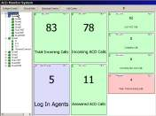
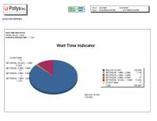
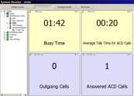
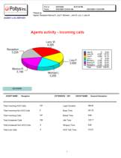
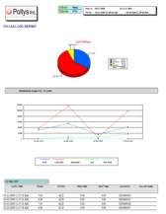


Improved Work Efficiency
Call Centre Solution - “CC View” Activity Monitor and Report Tool
“CC View” provides a more detailed activity monitor and reports than the built-in function (page 41-42).
Monitoring screen sample
Report sample
71

Slide 71









Improved Work Efficiency
Communication Assistant
Lineup
For details, see page 48, 56, 73-92.
CA Basic-Express, CA PRO
CA Operator Console
- For Personal Productivity,
- For General Offices
- For Operators / Agents
- For Reception / Secretaries
Intuitive point and click telephony fully featured with real-time presence indication Stay informed of users availability in different locations.
An agent can use the software to easily handle calls, and professionally handle communication between customers and colleagues.
CA Supervisor
- For Team / Group Productivity
- For Call Centres
A team supervisor can easily monitor and manage the real-time telephony activities of group members and agents.
CA Basic-Express
Free
CA PRO
72

Slide 72



Improved Work Efficiency
Communication Assistant
Presence
Users can save time and enjoy smoother communication by checking the status of co-workers on a PC screen right at their desk. Users can also choose the most suitable communication method to make calls, send e-mails, or chat with others, depending on the situation.
Extension Status
Idle
Ringing
On the phone
I'm in a meeting
so please leave a message.
I will call you back when I return.
CA Status
The user is logged in
The user is logged in,
but the auto absent
message has been set
The user isn't logged in
Absent Message
Will Return Soon
A personal greeting set in the Unified Messaging system can be specified in the settings of each presence status.
Callers redirected to the user’s
mailbox will hear the personal greeting assigned to the current presence status.
Not At My Desk
Gone Home
Available
Urgent Only
In a Meeting
73

Slide 73




Improved Work Efficiency
Communication Assistant
Conference Feature
Using the conference function, you can create ten conference groups of up to 32 people, simply by dragging and dropping members from the contact list. Conference groups can be entered with a group name of your choice.
Only three clicks are required to start a conference.
Editing conference group settings
Conference room window
To add members to a conference, drag and drop contacts from the contact list to the conference setting window, or right-click a contact and select Add Member To Conference.
During a conference, the originator of the conference can enable or disable the ability of other members to speak, put them on hold, or remove them from the conference.
Drag
&
Drop
74

Slide 74



Improved Work Efficiency
Communication Assistant
Microsoft Outlook Integration
CA can seamlessly integrate with Microsoft Outlook® 2003/2007/2010. During the installation of CA Client, if you select to add call functions to Outlook, a toolbar will be added to Outlook. The toolbar offers many of the call features of CA Client.
Pop-up Outlook Contact Window for Incoming Calls
Outlook Tool Bar
When a call is incoming, the Outlook contact information of that caller will appear.
75

Slide 75


Improved Work Efficiency
Communication Assistant
Microsoft Exchange Server Integration
If a CA server is installed on your network, you can integrate a Microsoft Exchange calendar with CA Client. When this is done, your presence will automatically change according to the content of your Exchange calendar (by referring to a matching table).
You can also set keywords in your calendar's schedule to change your presence.
If there is a schedule at the time
CA Client presence automatically changes
Personal greeting message also changes according to the schedule
I’m in a meeting now.
Please leave your message.
Change built-in UM (voice mail) greeting message according to presence
Synchronize with
calendar information
Matching Table
KX-NS500
Exchange Server
CA Server
<Note>
The supported versions of Exchange Server are 2007 and 2010. 2003 is not supported.
76

Slide 76
Improved Work Efficiency
Communication Assistant
CRM Integration (TAPI/CSTA Support)
CRM integration enables linking with a wide range of CRM software by installing middleware.
CA Client also has a 1st party TAPI, which is a standard interface.
Functions that can be linked with CRM software include call pop-ups using caller ID, the CRM phone book, and calling from applications.
For information about middleware and supported CRM software types, contact your Panasonic sales company.
77

Slide 77




Improved Work Efficiency
Communication Assistant
Thin Client Environment Support
CA Client can be used in a thin client environment. The supported thin client environments are Citrix XenApp™ and Microsoft Terminal Service. A CA server and a thin client activation key (KX-NSA010) are required to enable thin client support.
Since personal information such as address books is not retained on the client PCs, safety is enhanced from an information security perspective.
CA Server
Thin Client Server
CA Server
CA Client
CA Client
CA Client
CA Client
CA Client
CA Client
<NOTE>
When using CA Client in a thin client environment, the following features are not available:
IP Softphone, 1st Party TSP features, 3rd Party CRM Integration, Microsoft Outlook Integration
78

Slide 78






Improved Work Efficiency
Communication Assistant
Network Camera Integration
Panasonic network cameras can integrate with a CA desktop PC. This allow users to view video on their PC from a remote location simply by clicking the access web in the CA contact list. By linking a registered door phone, users can also answer calls and open the door after confirming video on the screen.
Entrance
Doorphone
On your desk
Reception
Factory
Office
<NOTE>
Browser for viewing: Internet Explorer® 6.0 or later
79

Slide 79



Improved Work Efficiency
Communication Assistant
Follow me function (CA integration with public telephone numbers)
CA can work with mobile phones or home phones. Home workers can make calls using the KX-NS500, to reduce telephone charges. Outgoing and internal calls can be made by using CA when outside.
Home
KX-NS500
PSTN/
IP Trunk
<Drop-Down List>
Phone (Office): 8012
Phone (Mobile): 0901234567
Phone (Home): 0921234567
Custom Phone Number Extension
Home worker
Call
Customer
80

Slide 80


Improved Work Efficiency
Communication Assistant
CA Operator Console - Overview
CA Operator Console
For
- Agents
- Receptionists
Easy Call Handling
Users can manage multiple calls simultaneously using a graphic interface.
Extension Setting
Various extension settings can be set.
- Set a wake-up call
- Set and clear the absent message, etc.
81

Slide 81

Improved Work Efficiency
Communication Assistant
CA Operator Console - Easy Call Handling
The status of received and parked calls are displayed in the Arriving Calls Screen, allowing a single agent to handle multiple controls. Agents can easily transfer and park calls with a simple drag & drop operation.
Drag & drop
for transfer
Drag & drop
for parking
82

Slide 82





Improved Work Efficiency
Communication Assistant
CA Operator Console - Extension Settings
Operators can set and change the settings of each extension.
Operators can set the following
- FWD/DND
- Clear the extension PIN
- Set a wake up call
- Set/clear absent message
- Extension lock/unlock
Example: Set a wake up call
For the Hospitality Industry
83

Slide 83

Improved Work Efficiency
Communication Assistant
CA Supervisor - Overview
CA Supervisor
For
- Supervisors
- Managers
Real-time Status Management
Supervise customer call handling by monitoring in real-time the number of calls waiting and the longest wait time.
Monitor agent status and control login and logout operations.
Manage the performance of all agents in a group.
Agent Support
Support agents who need help with difficult customer calls. (Listen-in, Busy Override, etc.)
84

Slide 84

Improved Work Efficiency
Communication Assistant
CA Supervisor - Real-time Status Management
Supervisors can monitor the status of a target group’s agents with the Group Call Monitor feature.
Current Waiting Call
Longest Waiting Time
Login/Logout Status
Total Incoming Calls
Average Waiting Time
Lost Calls
Overflow Calls
85

Slide 85

Improved Work Efficiency
Communication Assistant
CA Supervisor - Agent Support
Supervisors can support agents who need help with difficult customer calls.
Listen-In
Supervisors can listen in to the conversation of any agent extension number.
Call
Customer
Agent
Listen
Take Over
Supervisors can take over the telephone conversations of agent extension numbers.
Busy Override
Supervisors can override the call of any agent extension number.
Supervisor
86

Slide 86


Improved Work Efficiency
Communication Assistant -CA Modules as CA Family-
CA Modules as CA Family
1. Conference Bridge
Click!
CA Modules screen
2. Appointment Reminder
3. Speech Auto Attendant
4. Outbound Dialer
Select an application
5. ACD Reports
87

Slide 87









Improved Work Efficiency
Communication Assistant -CA Modules as CA Family-
Conference Bridge Module
The CA Conference Bridge module provides a conference room for multi-party audio conferences.
The conference schedule and participants can be set or maintained by the supervisor.
Meet-me conference
Call an access number
for a conference room
Set conference schedule and participants
Scheduled Meet-Me conference
Automatic scheduled dial-out conference
Maximum 50 conference rooms
Maximum 96 participants per room
Total of 100 simultaneous attendees per system
Supervisor
Conference
Room
88

Slide 88

Improved Work Efficiency
Communication Assistant -CA Modules as CA Family-
Appointment Reminder Module
The CA Appointment Reminder module places outbound calls to deliver specific appointment reminder information to each called recipient at a pre-defined date and time. It is useful for preventing customer no shows.
The CA module calls automatically at a pre-defined date and time.
(24 hours before, etc.)
Prevent users from forgetting to contact customers and check schedules.
Reduce the work required for agents to make telephone calls.
Customer
Text to speech;
A Panasonic restaurant table reservation confirmation call will be sent to you at 18:30 tomorrow.
Press1 to confirm.
If the customer accepts the appointment, they dial “1”.
The operation is then recorded.
89

Slide 89
Improved Work Efficiency
Communication Assistant -CA Modules as CA Family-
Speech Auto Attendant Module
The CA Speech Auto Attendant module provides a call routing function. Calls are redirected to voicemail or a mobile phone, etc. according to the CA status after the caller tells the module the name of the caller they want to talk to.
Customer calls Speech Auto Attendant.
Customers can connect to people in charge without pressing buttons
When the agent a customer wants to talk to is absent, the customer can leave voice mail or a message for another person in charge
By simply changing the CA status, communication can be performed with a method according to that status
Customer
Text to speech;
“This is Panasonic. Who do you want to talk to?”
Customer speaks;
James Bond
The CA module specifies the destination by speech recognition, and decides the action to take according to the CA status.
Text to speech; for “In a meeting”
“This is James. I am in a meeting. Please leave a message.”
The call will be transferred to voice mail.
Text to speech; for “Gone home”
“This is James. I have gone home. Please call my secretary.”
The call will be transferred to the predefined destination.
90

Slide 90

Improved Work Efficiency
Communication Assistant -CA Modules as CA Family-
Outbound Dialer Module
The CA Outbound Dialer module is a productivity tool that automatically places calls to a predefined list of phone numbers when the agent is idle.
It is useful for reducing misdialing and the time it takes to enter phone numbers.
Reduce call mistakes made by agents and the time it takes to dial.
Reduce the time that agents are free to improve work efficiency.
Agent A
Automatically call customers one by one according to a predefined list.
1st
call
2nd call
3rd call
Customer A
Customer B
Customer C
91

Slide 91


Improved Work Efficiency
Communication Assistant -CA Modules as CA Family-
ACD Reports Module
The CA ACD Reports module is a productivity tool that provides Call Centre reporting features, adding ACD Call Centre specific functionality to CA.
By adding the CA module to CA Supervisor, monitoring and reporting can be provided on one PC.
Call
Analyze the status of calls and any problems to improve customer service.
Save the status of calls as data.
Customer A
Agent A
Call
Customer B
KX-NS500
Agent B
Monitor and report of Call centre activity
Live Status Monitor/Reporting
Related functions
Call Centre Solution - For details, see page 37-42, 71
Supervisor
92

